Slide 1

Saguturu
TEXTSUMMARIZATION USING NLP
By:
Kishan Sai Saguturu 00951675
MINOR PROJECT

Slide 2


CONTENTS
>
Introduction
>
Literature Survey
>
Methodology
>
Implementation and Results
>
Conclusion and Future Work

Slide 3



Introduction
Text summarization is the process of creating a shorter version of a longer text while retaining its most important information.
It has become an important tool in natural language processing (NLP) due to the exponential growth of digital data and the need to quickly extract relevant information.
Efficiently extract important information from long documents
Provide a quick overview of a document's content.
Reduce reading time and increase productivity.
SUMMARIZE

Slide 4
Literature Survey
Document Summarization with Latent Queries by Yumo Xu and Mirella Lapata published on Transactions of the Association for Computational Linguistics, May 2022
Methodology:
This paper presents a unified modeling framework for generic and query-focused summarization, optimizing a latent query model and a conditional language model. It also introduces a non-parametric calibration method for handling user queries at test time.
Performance Analysis:
It demonstrates superior performance of the proposed model on various summarization benchmarks, surpassing strong baselines and existing methods on out-of-distribution queries, supported by ablation studies and qualitative analysis.
Limitation and Consideration:
There are few limitations in the model, including potential issues with summary fidelity and capturing complex query intents. Future work suggestions include incorporating factual consistency constraints, enhancing query representation learning and exploring diverse query types.

Slide 5
Literature Survey
Extractive Summarization of Call Transcripts by Pratik K. Biswas and Aleksandr Iakubovich published on Transactions of the Association for Computational Linguistics, May 2022
Methodology:
This paper proposes a novel method for extractive summarization of call transcripts, which combines topic modeling, sentence selection and punctuation restoration.
Performance Analysis:
The performance of the method on four different use cases and compares it with another open-source summarizer. The paper reports that the proposed method achieves higher rouge-l scores and punctuation-restoration-accuracy scores than the baseline summarizer.
Limitation and Consideration:
The paper addresses limitations and considerations, including dependency on speech-to-text conversion quality, trade-offs between summary length and information content, and the need for improved punctuation restoration.

Slide 6
Methodology
Keywords:
Spacy_rander, Natural Language Processing, Summarization, Streamlit, en_core_web_sm.
Step 1: Text Preprocessing Clean the text by removing stop words, punctuation, and other irrelevant information. | Step 2: Tokenization Break the text into individual words or phrases.
Step 3: Part-of-Speech Tagging Identify the part of speech (noun, verb, adjective, etc.) of each word in the text. | Step 4: Named Entity Recognition Identify and extract named entities (people, organizations, locations, etc.) from the text.
Step 5: Sentiment Analysis Determine the overall sentiment of the text (positive, negative, neutral). | Step 6: Text Summarization Create a concise summary of the text, highlighting the most important information.

Slide 7
Step 1: Text Preprocessing
Text preprocessing is the first step in our project. It is the process of bringing the text into a form that is predictable and analyzable for a specific task.
﻿
A task is the combination of approach and domain. For example, extracting top keywords with TF-IDF (approach) from Tweets (domain) is an example of a task1.
﻿
The main objective of text preprocessing is to break the text into a form that machine learning algorithms can digest. It involves cleaning and transforming unstructured text data to prepare it for analysis.

Slide 8
Step 2: Tokenization &
Step 3: Parts-Of-Speech (POS)
﻿Tokenization is a key step in natural language processing (NLP) where text is divided into individual words or tokens. This allows for more detailed analysis and understanding of the text's structure and meaning.
POS tagging assigns grammatical tags to each word in a sentence, indicating its syntactic category (e.g., noun, verb, adjective). This helps in analyzing the sentence's structure and extracting valuable linguistic information.
Tokenization and POS tagging are essential preprocessing steps in NLP, enabling more accurate and in-depth analysis of text data.

Slide 9

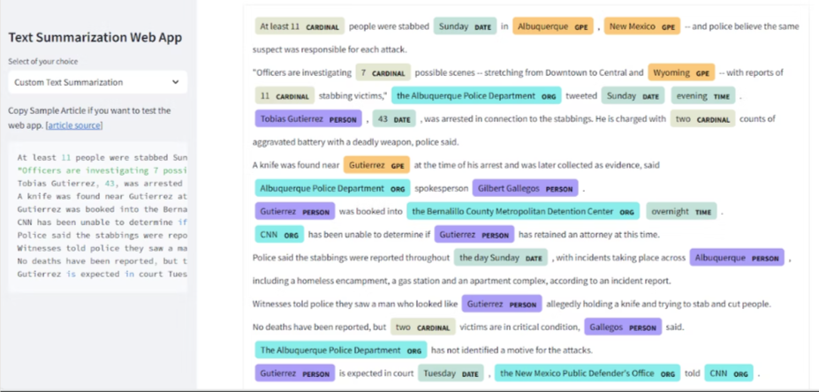
Step 4: Name Entity Recognition & Step 5: Sentiment Analysis
Named Entity Recognition is used to identifies and classifies named entities in text, such as people, organizations, locations, and dates. It helps extract valuable information and understand the context of the text, benefiting applications like information retrieval and text summarization.
Sentiment Analysis, or opinion mining, determines the sentiment expressed in text, whether positive, negative, or neutral. Sentiment Analysis provides valuable insights for our data-driven decision-making.

Slide 10
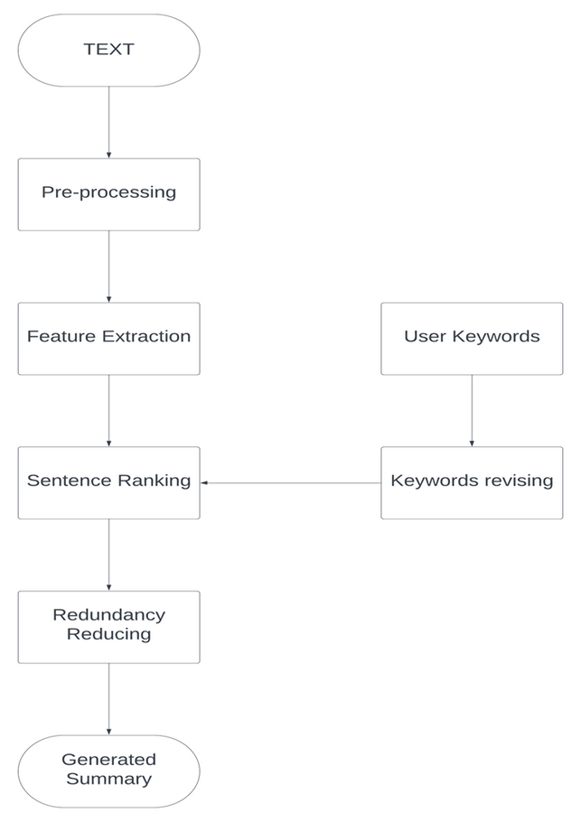
Step 6: Text Summarization & Architecture diagram
Text summarization is a vital NLP technique that condenses a given text while preserving its key information. It involves generating a concise summary that captures the main ideas.
There are two approaches:
Extractive Summarization: Selects important sentences or phrases from the original text to create a summary.
Abstractive Summarization: Generates a summary by understanding the text's meaning and expressing it in a new way.

Slide 11
Results and Discussion
The project implements a text summarization system using NLP techniques and a pre-trained summarizer model (spaCy) based on the Transformer architecture.
The system generates concise and informative summaries for BBC News articles and custom articles.
It leverages the Transformer's self-attention mechanism to capture important information and produce coherent summaries.
The generated summaries are generally accurate, but some details from the original text may be lost due to the limitations of automatic summarization.
The project demonstrates successful application of NLP and the Transformer architecture for text summarization.
It provides a foundation for future advancements in the field of text summarization.

Slide 12
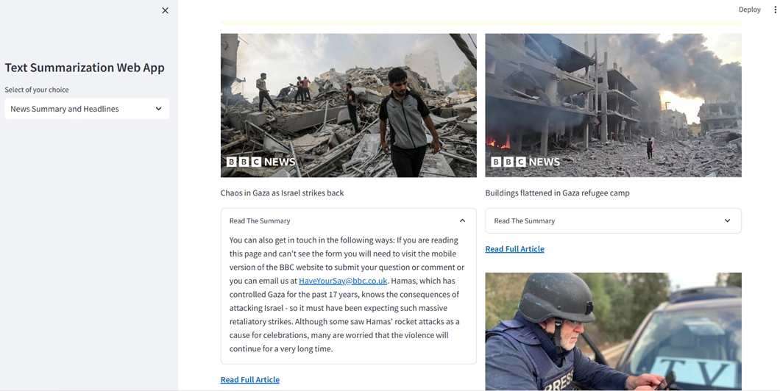
Result
Figure : News Headlines and Summary

Slide 13
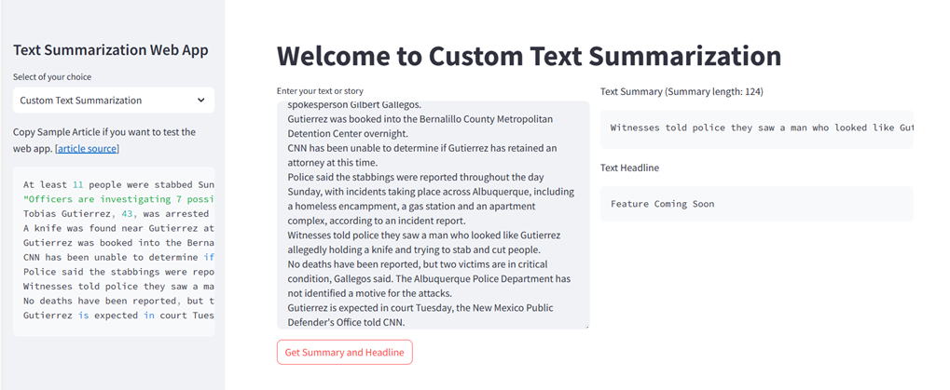
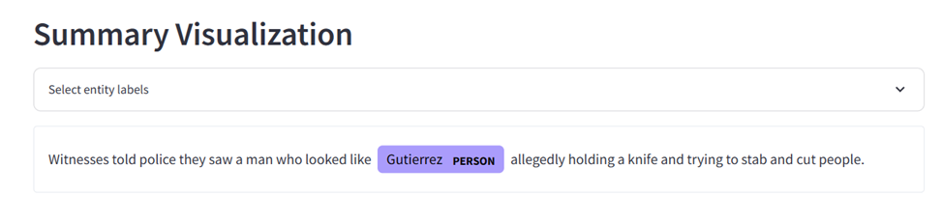
Result
Figure : Custom Text Summarization
Figure: Summary Visualization

Slide 14
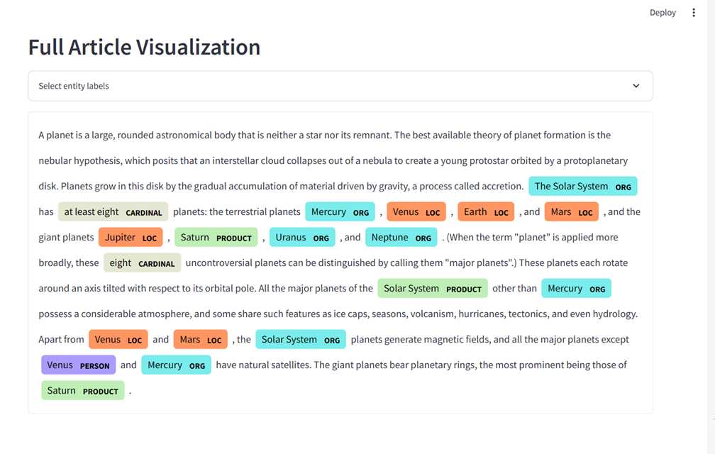
Result
Figure: Full Article Visualization

Slide 15

Conclusion and Future Work
In conclusion, text summarization using NLP is a promising field with many potential applications in various industries. Our methodology has shown promising results in summarizing news articles from BBC News, and we believe that with further research and development, it can be applied to other types of text as well.
Moving forward, we plan to explore the use of deep learning models for text summarization, as well as incorporating more advanced NLP techniques such as sentiment analysis and entity recognition. We also plan to expand our dataset to include a wider range of text sources and languages.

Slide 16
References
[1] Mingyang Geng, Shangwen Wang, Dezun Dong, Haotian Wang, Shaomeng Cao, Kechi Zhang, Zhi Jin.
"Interpretation-based Code Summarization" (2023).
[2] Aakash Bansal, Chia-Yi Su, Collin McMillan.
"Revisiting File Context for Source Code Summarization" (2023).
[3] Chia-Yi Su, Collin McMillan.
"Distilled GPT for Source Code Summarization" (2021).
[4] Yao Wan, Zhou Zhao, Min Yang, Guandong Xu, Haochao Ying, Jian Wu, Philip S. Yu.
"Improving Automatic Source Code Summarization via Deep Reinforcement Learning" (2020).
[5] Wenhua Wang, Yuqun Zhang, Yulei Sui, Yao Wan, Zhou Zhao, Jian Wu, Philip S. Yu and Guandong Xu.
"Reinforcement-Learning -Guided Source Code Summarization Using Hierarchical Attention" (2020).
[6] Yumo Xu and Mirella Lapata. "Document Summarization with Latent Queries" (2021).
[7] Mingyang Geng, Shangwen Wang, Dezun Dong, Haotian Wang, GeLI, Zhi Jin, Xiaoguang Mao and Xiangke Liao.
"An Empirical Study on Using Large Language Models for Multi-Intent Comment Generation" (2023).
[8] Partik K Biswas, Aleksandr lakubovich.
"Extractive Summarization of Call Transcripts" (2022)

Slide 17

Thank you!
Team:
Mohamed Yaseen M S RA2011026040020
Kishore Ramesh RA2011026040040
Saguturu Kishan Sai RA2011026040031
Guide:
Mr. Muthurasu N

Slide 18
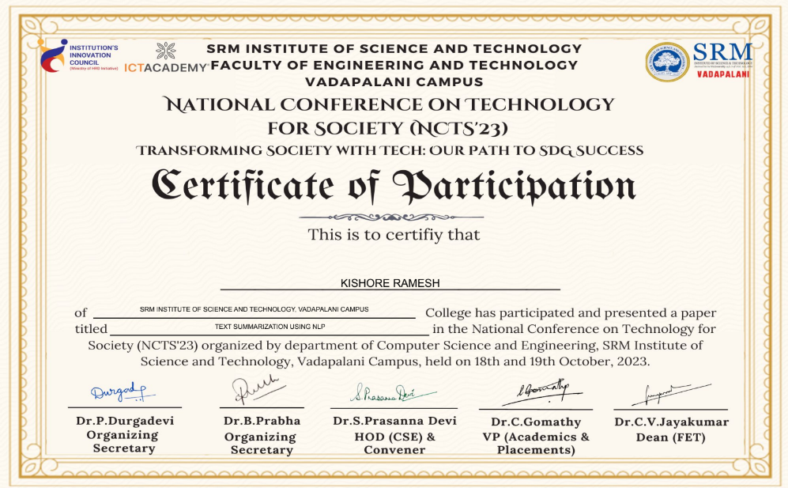
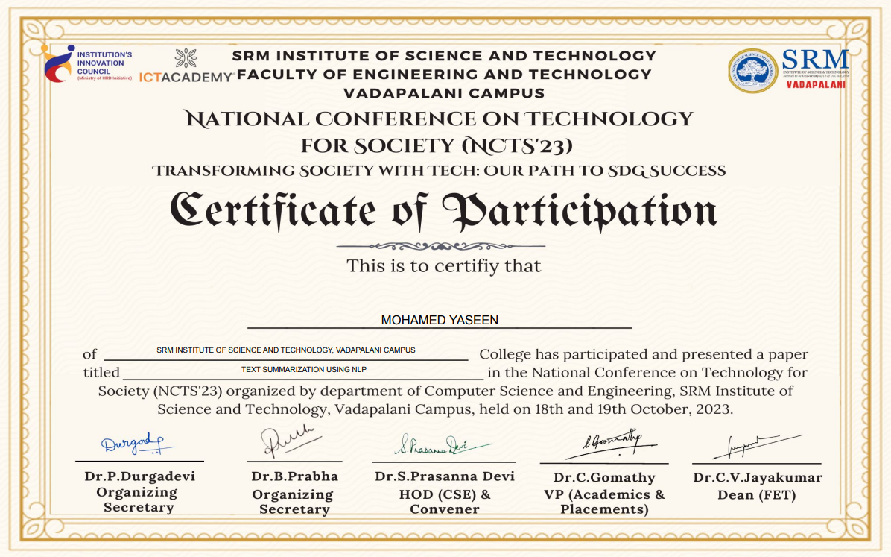
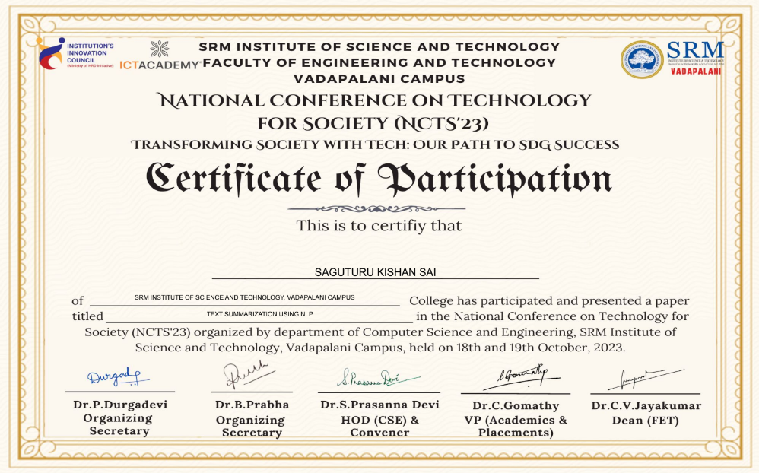
Conference Certificate

